Slide 1
Lecture 2 Linear transformations and Diagonalization
refs.
Contemporary Linear Algebra, H Anton, RC Busby

Slide 2

카카오톡 단톡방 MATLAB KR
https://open.kakao.com/o/gKBr7Zde

Slide 3
1. Linear transformation

Slide 4
1.1 Standard matrix for a linear transformation

Slide 5
So, what is a matrix?
Five perspectives on viewing matrices
Collection of data (numeric)
Collection of vectors (geometric)
A system of linear equations (algebraic)
A linear transformation (operational)
A tangent space of a function (differential)

Slide 6
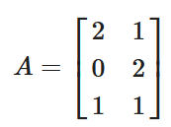
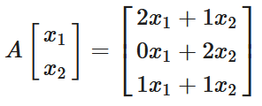
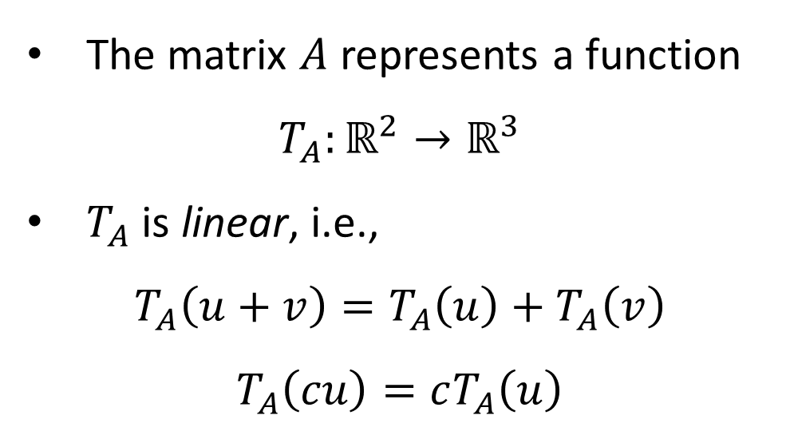
Matrix as a linear transformation
The matrix $A$ represents a function
$$T_{A}:ℝ^{2}→ℝ^{3}$$
$T_{A}$ is linear, i.e.,
$$T_{A}\left(u+v\right)=T_{A}\left(u\right)+T_{A}\left(v\right)$$
$$T_{A}\left(cu\right)=cT_{A}\left(u\right)$$

Slide 7
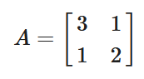
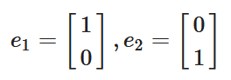
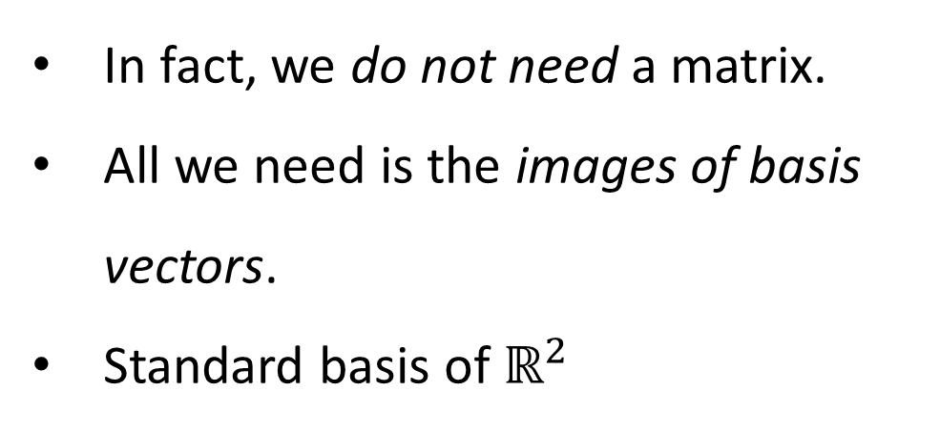
Matrix as a linear transformation
In fact, we do not need a matrix.
All we need is the images of basis vectors.
Standard basis of $ℝ^{2}$

Slide 8
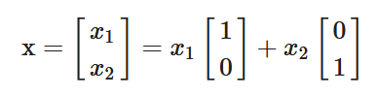
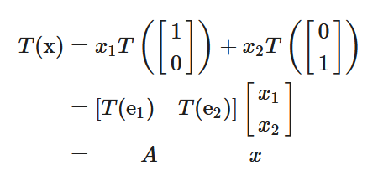
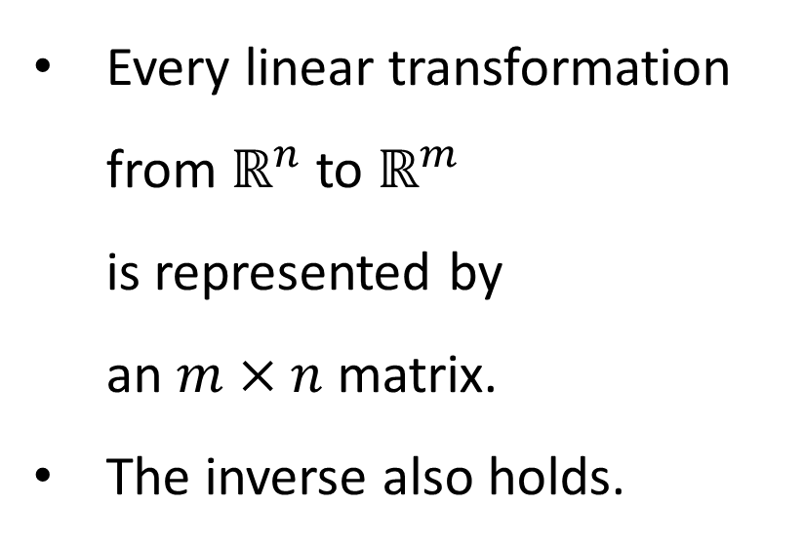
Standard matrix
Every linear transformation from $ℝ^{n}$ to $ℝ^{m}$ is represented by an $m×n$ matrix.
The inverse also holds.
Standard matrix for $T$, denoted by $\left[T\right]$ ➔ $T\left(x\right)=\left[T\right]x$

Slide 9
Examples of linear transformations
Stretch / compression
Shear
Rotation
Reflection
lab: example_matrix_is_a_linear_transformation.m
Q. Is translation a linear transformation? (cf. Affine transformation)
source: 공돌이의 수학 정리 노트

Slide 10
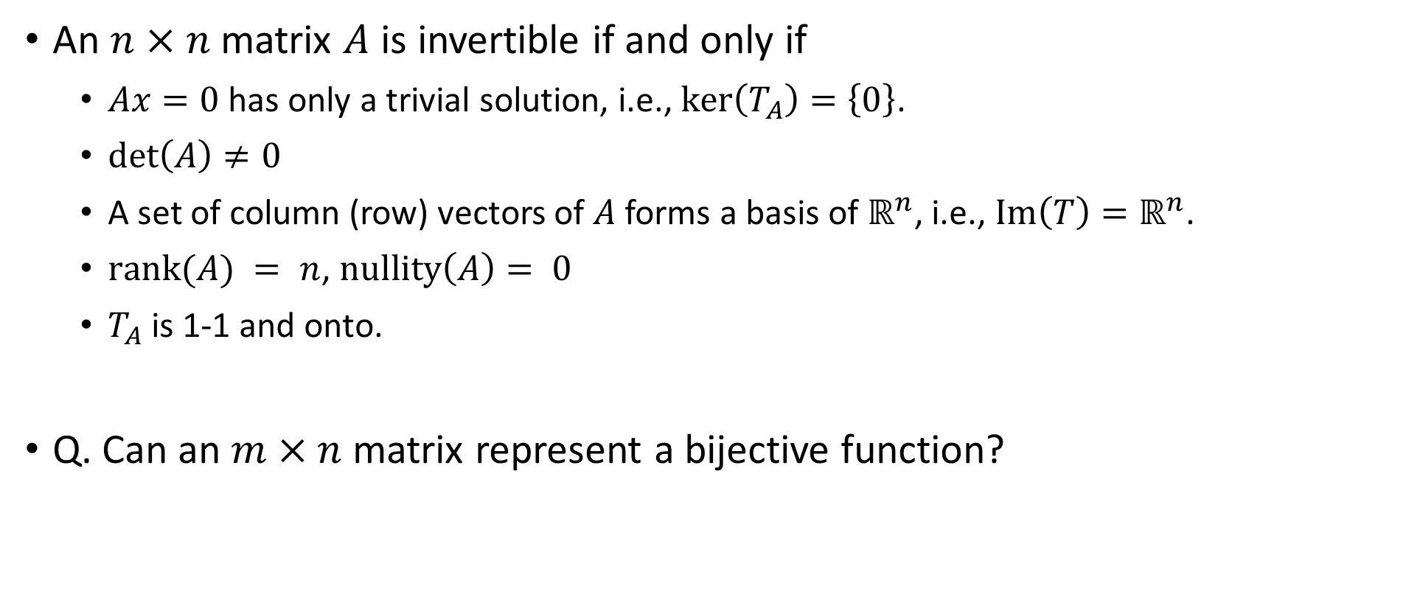
Invertibility of a square matrix
An $n×n$ matrix $A$ is invertible if and only if
$Ax=0$ has only a trivial solution, i.e., $\ker\left(T_{A}\right)=\left\{0\right\}$.
$\det\left(A\right)≠0$
A set of column (row) vectors of $A$ forms a basis of $ℝ^{n}$, i.e., $Im\left(T\right)=ℝ^{n}$.
$rank(A) = n$, $nullity\left(A\right)= 0$
$T_{A}$ is 1-1 and onto.
Q. Can an $m×n$ matrix represent a bijective function?

Slide 11
Direction of stretching
lab: example_matrix_is_a_linear_transformation.m

Slide 12
1.2 Projection and least square

Slide 13
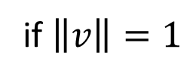





Projection formula
Projection of $x$ onto $v$
$${\text{proj}}_{v}x=\frac{x⋅v}{{\left\|v\right\|}^{2}}v$$
$$=\left(x⋅v\right)v$$
if $\left\|v\right\|=1$
Every vector $x$ in $ℝ^{n}$ is uniquely expressed as
$$x={\text{proj}}_{v}x+{\text{proj}}_{v^{⊥}}x$$

Slide 14
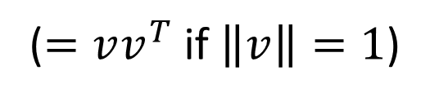


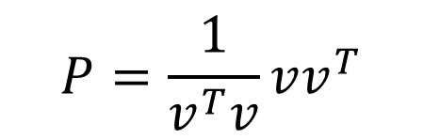

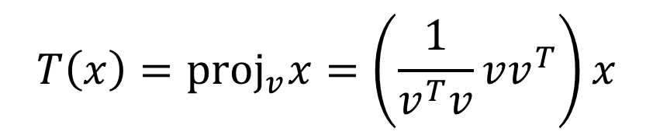
Projection operator
Projection operator onto $span\{v\}$
$$T\left(x\right)={\text{proj}}_{v}x=\left(\frac{1}{v^{T}v}vv^{T}\right)x$$
Standard matrix for $T$
$$P=\frac{1}{v^{T}v}vv^{T}$$
($=vv^{T}$ if $\left\|v\right\|=1$)
Q. $rank(P)=?$

Slide 15



Projection onto a subspace
Projection of $x∈ℝ^{n}$ onto $W≤ℝ^{n}$
$${\text{proj}}_{W}x=M{\left(M^{T}M\right)}^{−1}M^{T}x$$
where the column vectors of $M$ form a basis of $W$.
lab: example_projection_operator.m

Slide 16
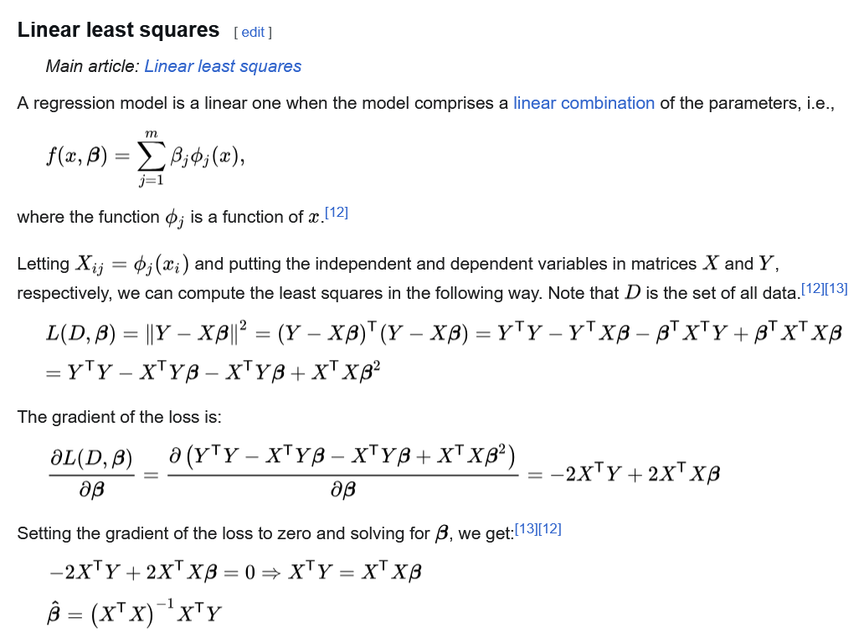

Least square and projection operation
$${\text{proj}}_{W}x=M{\left(M^{T}M\right)}^{−1}M^{T}x$$

Slide 17
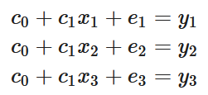
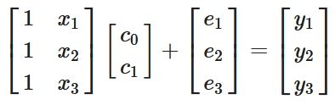
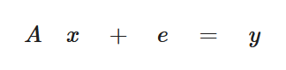

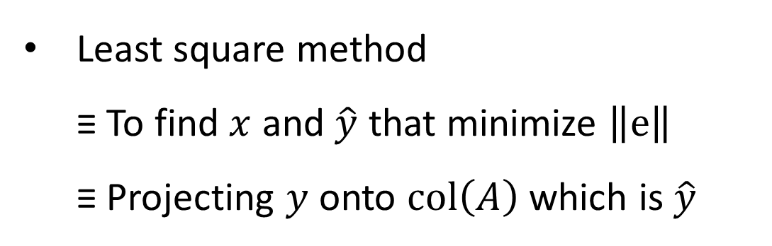
Ordinary Least Squares
Least square method ≡ To find $x$ and $\hat{y}$ that minimize $\left\|e\right\|$ ≡ Projecting $y$ onto $col\left(A\right)$ which is $\hat{y}$
$${\text{proj}}_{col\left(A\right)}y=A{\left(A^{T}A\right)}^{−1}A^{T}y$$
lab: example_least_square_is_projection.m

Slide 18
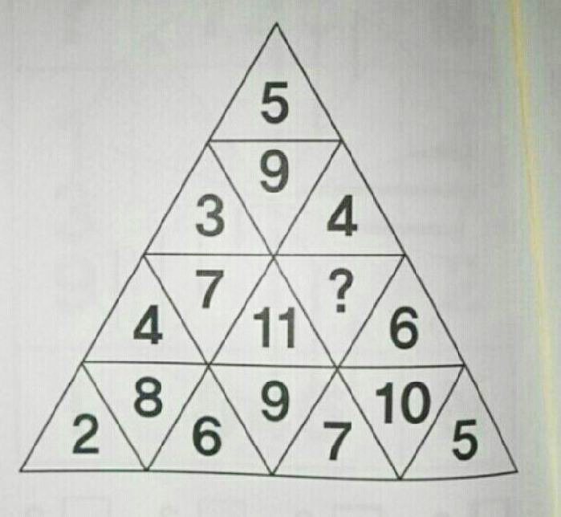
Linear regression example(?)
lab: example_triangle_game.m

Slide 19



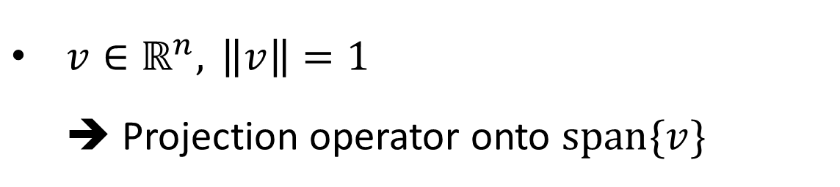

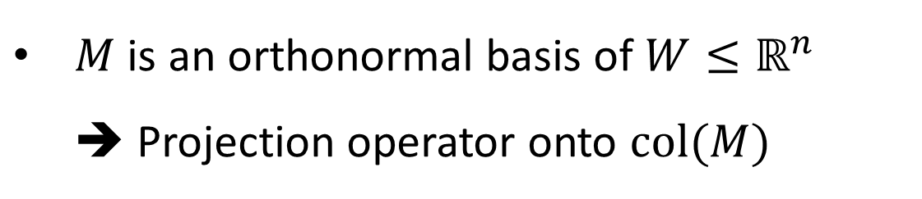

Orthonormal basis
$v∈ℝ^{n}, \left\|v\right\|=1$ ➔ Projection operator onto $span\{v\}$
$$T\left(x\right)=\left(vv^{T}\right)x$$
$M$ is an orthonormal basis of $W≤ℝ^{n}$ ➔ Projection operator onto $col(M)$
Standard matrix for $T$
$$T\left(x\right)=M{\left(M^{T}M\right)}^{−1}M^{T}x$$
$$=MM^{T}x$$
Standard matrix for $T$

Slide 20
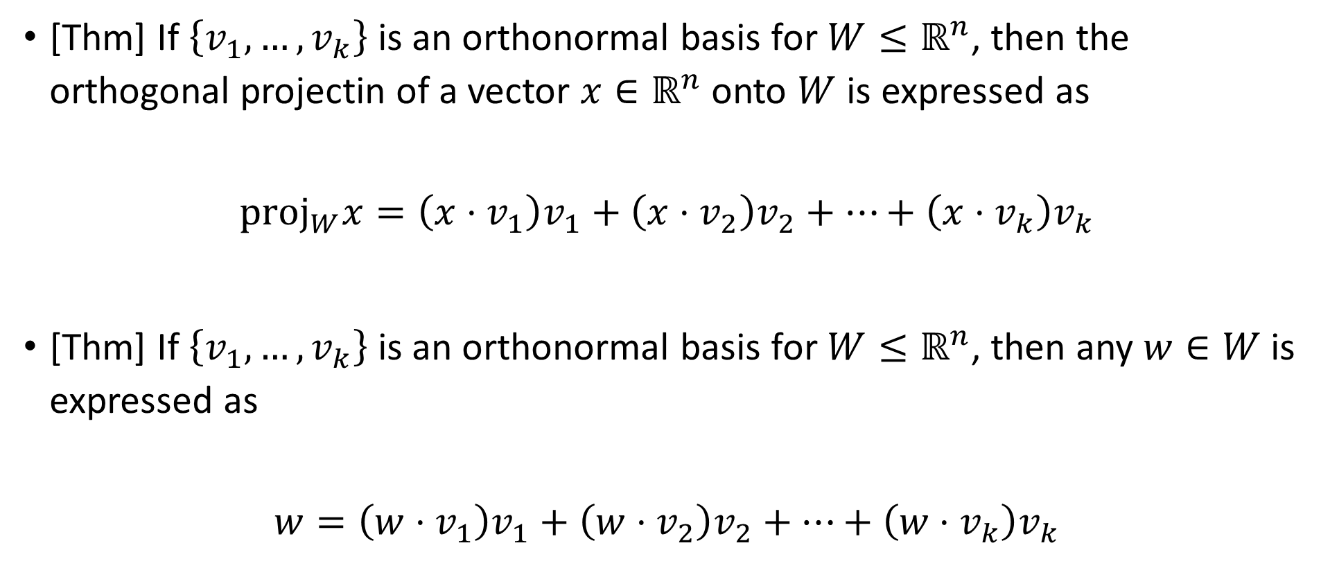
Why do we care orthonormal bases?
[Thm] If $\left\{v_{1},…,v_{k}\right\}$ is an orthonormal basis for $W≤ℝ^{n}$, then the orthogonal projectin of a vector $x∈ℝ^{n}$ onto $W$ is expressed as
$${\text{proj}}_{W}x=\left(x⋅v_{1}\right)v_{1}+\left(x⋅v_{2}\right)v_{2}+…+\left(x⋅v_{k}\right)v_{k}$$
[Thm] If $\left\{v_{1},…,v_{k}\right\}$ is an orthonormal basis for $W≤ℝ^{n}$, then any $w∈W$ is expressed as
$$w=\left(w⋅v_{1}\right)v_{1}+\left(w⋅v_{2}\right)v_{2}+…+\left(w⋅v_{k}\right)v_{k}$$

Slide 21
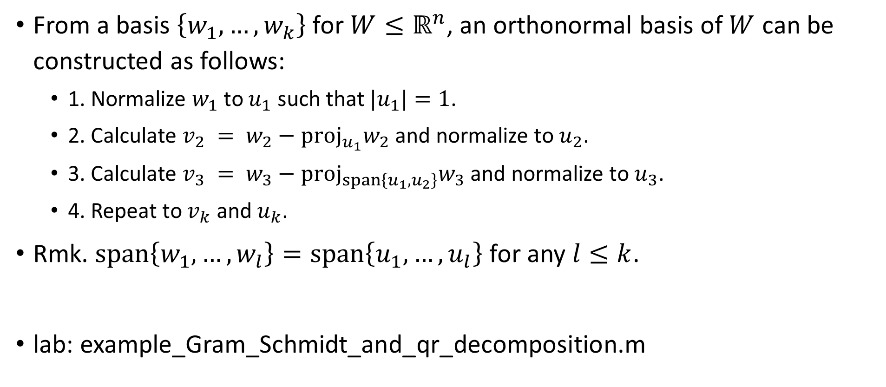
Gram-Schmidt and QR decomposition
From a basis $\left\{w_{1},…,w_{k}\right\}$ for $W≤ℝ^{n}$, an orthonormal basis of $W$ can be constructed as follows:
1. Normalize $w_{1}$ to $u_{1}$ such that $|u_{1}|=1$.
2. Calculate $v_{2} = w_{2}−{\text{proj}}_{u_{1}}w_{2}$ and normalize to $u_{2}$.
3. Calculate $v_{3} = w_{3}−{\text{proj}}_{span\left\{u_{1},u_{2}\right\}}w_{3}$ and normalize to $u_{3}$.
4. Repeat to $v_{k}$ and $u_{k}$.
Rmk. $span\left\{w_{1},…,w_{l}\right\}=span\left\{u_{1},…,u_{l}\right\}$ for any $l≤k$.
lab: example_Gram_Schmidt_and_qr_decomposition.m

Slide 22
2. Coordinate and change of basis

Slide 23
2.1 Vectors and coordinates

Slide 24
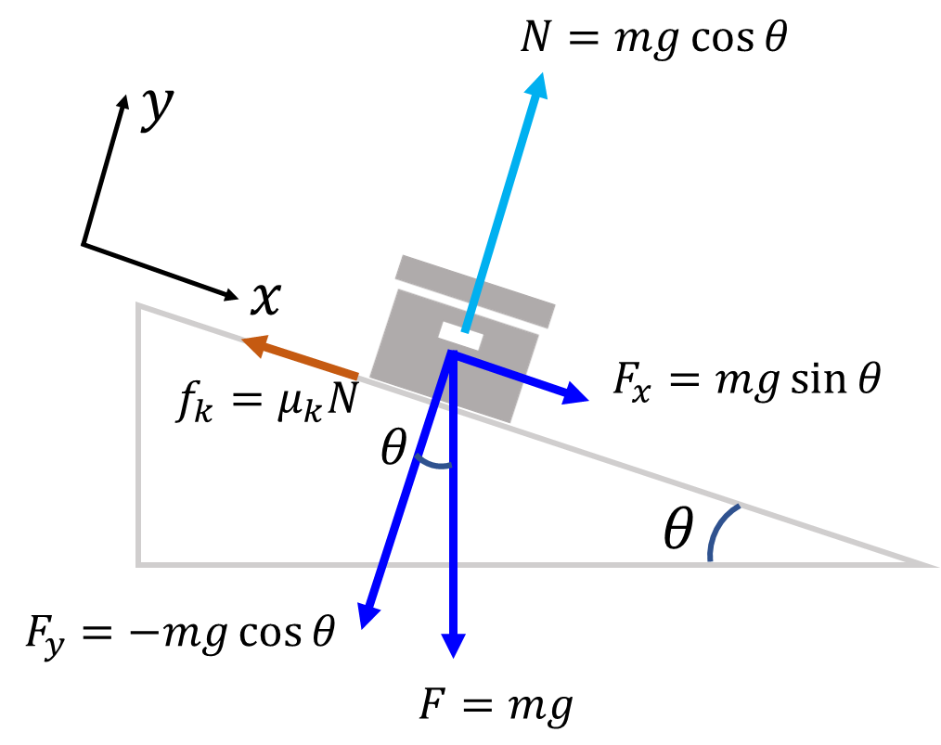
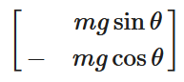
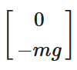
Making the familiar Unfamiliar
What is a vector?
An arrow?
A tuple of numbers?
Something with magnitude and direction?
Vector ≠ Coordinate
Standard basis is not that special.
vs

Slide 25
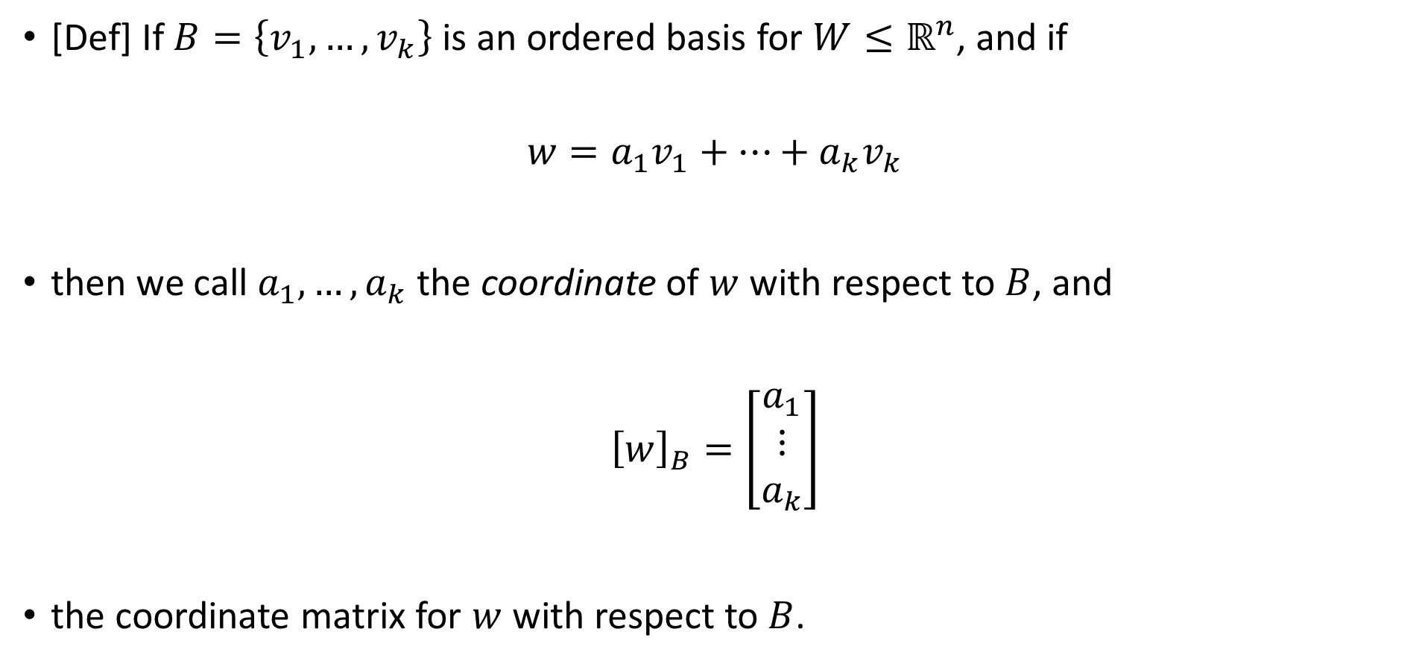
Coordinate of a vector
[Def] If $B=\left\{v_{1},…,v_{k}\right\}$ is an ordered basis for $W≤ℝ^{n}$, and if
$$w=a_{1}v_{1}+…+a_{k}v_{k}$$
then we call $a_{1},…,a_{k}$ the coordinate of $w$ with respect to $B$, and
$${\left[w\right]}_{B}=\left[\begin{matrix}a_{1} \\ ⋮ \\ a_{k}\end{matrix}\right]$$
the coordinate matrix for $w$ with respect to $B$.

Slide 26
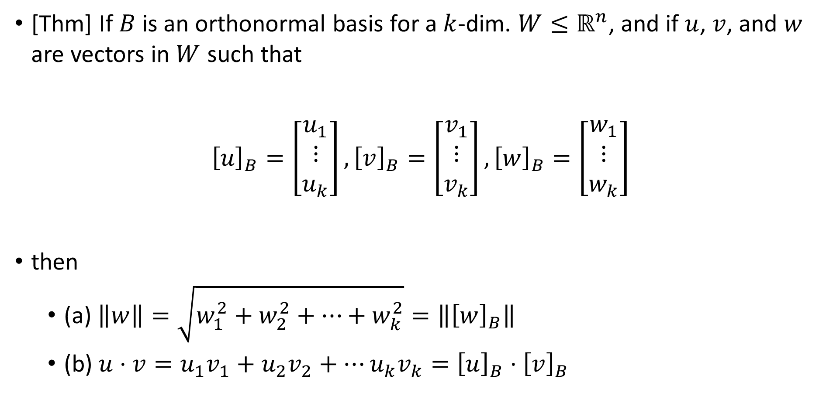
Why do we care orthonormal bases?
[Thm] If $B$ is an orthonormal basis for a $k$-dim. $W≤ℝ^{n}$, and if $u$, $v$, and $w$ are vectors in $W$ such that
$${\left[u\right]}_{B}=\left[\begin{matrix}u_{1} \\ ⋮ \\ u_{k}\end{matrix}\right],{\left[v\right]}_{B}=\left[\begin{matrix}v_{1} \\ ⋮ \\ v_{k}\end{matrix}\right],{\left[w\right]}_{B}=\left[\begin{matrix}w_{1} \\ ⋮ \\ w_{k}\end{matrix}\right]$$
then
(a) $\left\|w\right\|=\sqrt{w_{1}^{2}+w_{2}^{2}+…+w_{k}^{2}}=\left\|{\left[w\right]}_{B}\right\|$
(b) $u⋅v=u_{1}v_{1}+u_{2}v_{2}+…u_{k}v_{k}={\left[u\right]}_{B}⋅{\left[v\right]}_{B}$

Slide 27
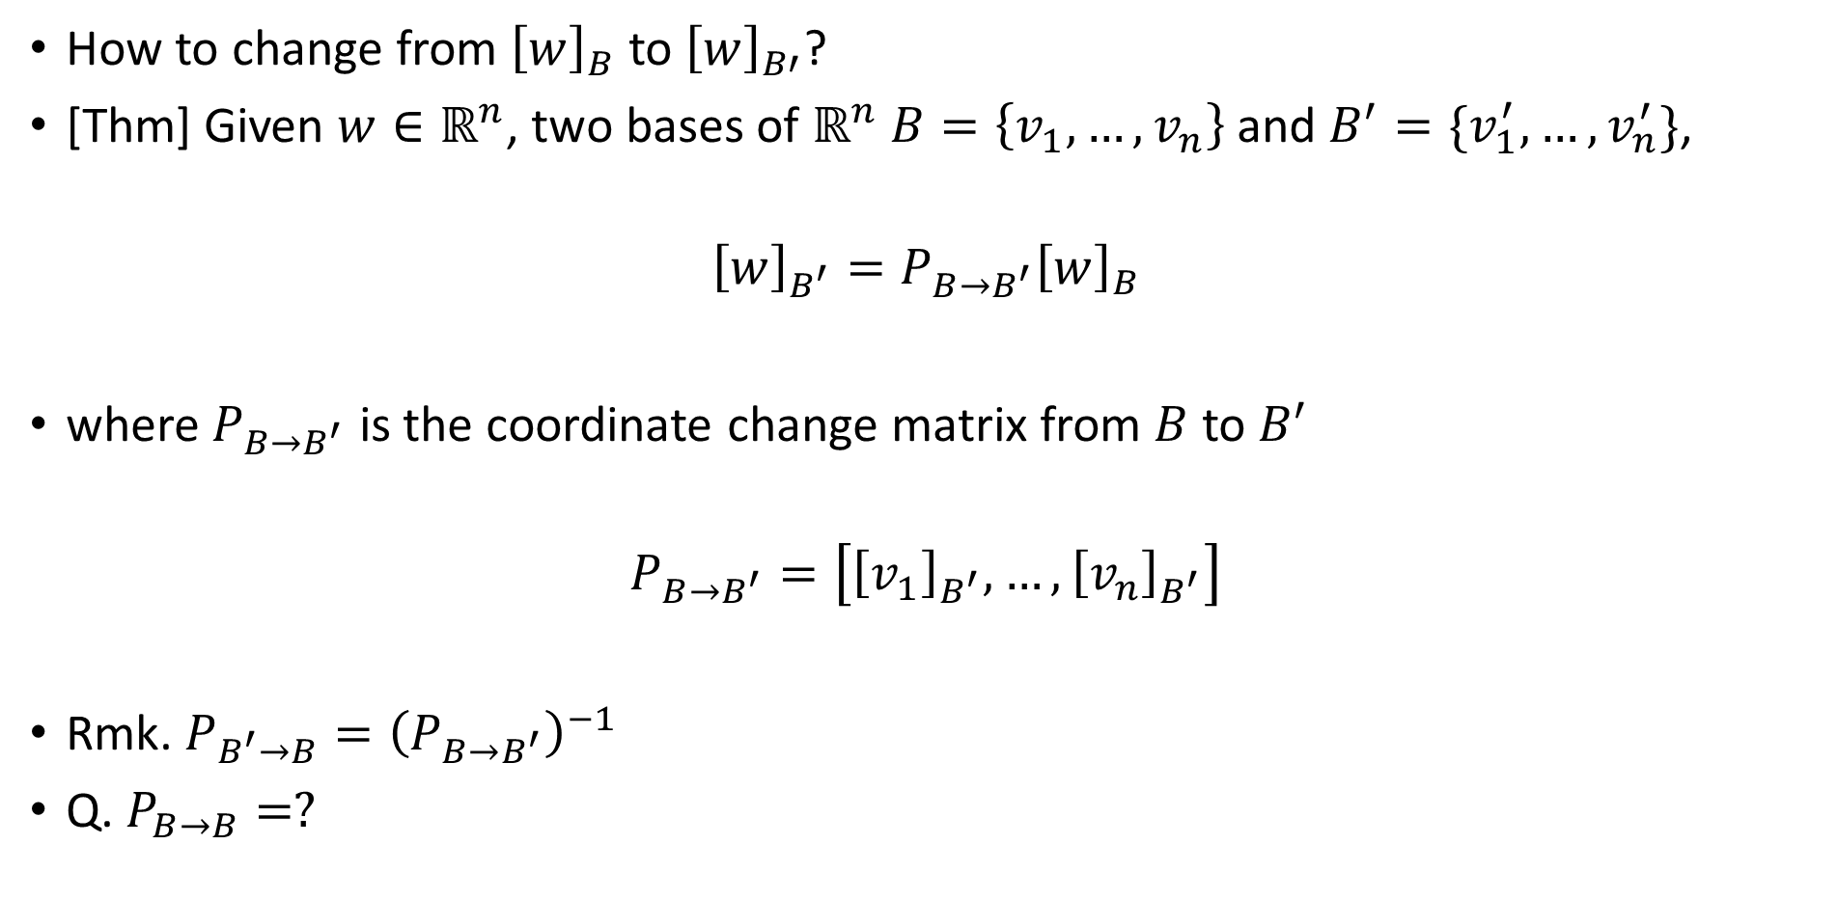
Change of basis
How to change from ${\left[w\right]}_{B}$ to ${\left[w\right]}_{B′}$?
[Thm] Given $w∈ℝ^{n}$, two bases of $ℝ^{n}$ $B=\left\{v_{1},…,v_{n}\right\}$ and $B^{′}=\{v_{1}^{′},…,v_{n}^{′}\}$,
$${\left[w\right]}_{B^{′}}=P_{B→B^{′}}{\left[w\right]}_{B}$$
where $P_{B→B^{′}}$ is the coordinate change matrix from $B$ to $B^{′}$
$$P_{B→B^{′}}=\left[{\left[v_{1}\right]}_{B^{′}},…,{\left[v_{n}\right]}_{B^{′}}\right]$$
Rmk. $P_{B^{′}→B}={\left(P_{B→B^{′}}\right)}^{−1}$
Q. $P_{B→B}=?$

Slide 28
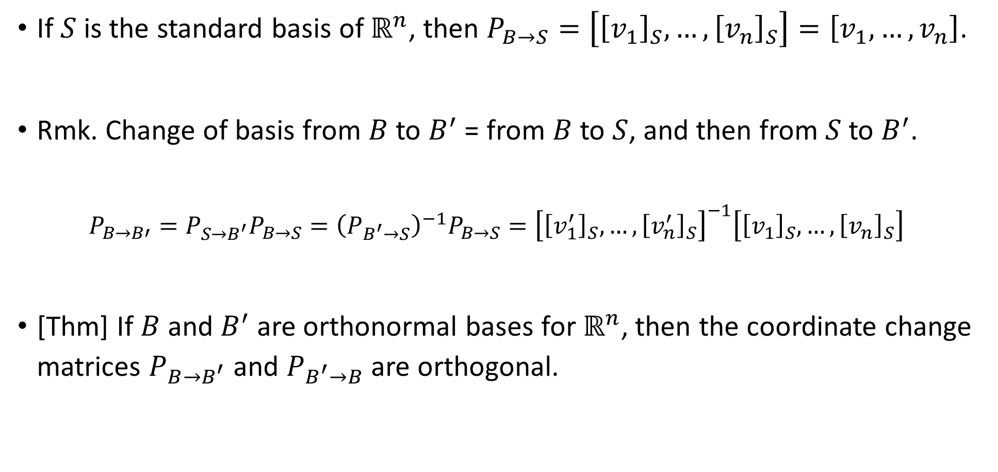
Change of basis
If $S$ is the standard basis of $ℝ^{n}$, then $P_{B→S}=\left[{\left[v_{1}\right]}_{S},…,{\left[v_{n}\right]}_{S}\right]=\left[v_{1},…,v_{n}\right]$.
Rmk. Change of basis from $B$ to $B^{′}$ = from $B$ to $S$, and then from $S$ to $B^{′}$.
$$P_{B→B′}=P_{S→B^{′}}P_{B→S}={\left(P_{B^{′}→S}\right)}^{−1}P_{B→S}={\left[{\left[v_{1}^{′}\right]}_{S},…,{\left[v_{n}^{′}\right]}_{S}\right]}^{−1}\left[{\left[v_{1}\right]}_{S},…,{\left[v_{n}\right]}_{S}\right]$$
[Thm] If $B$ and $B^{′}$ are orthonormal bases for $ℝ^{n}$, then the coordinate change matrices $P_{B→B^{′}}$ and $P_{B^{′}→B}$ are orthogonal.

Slide 29
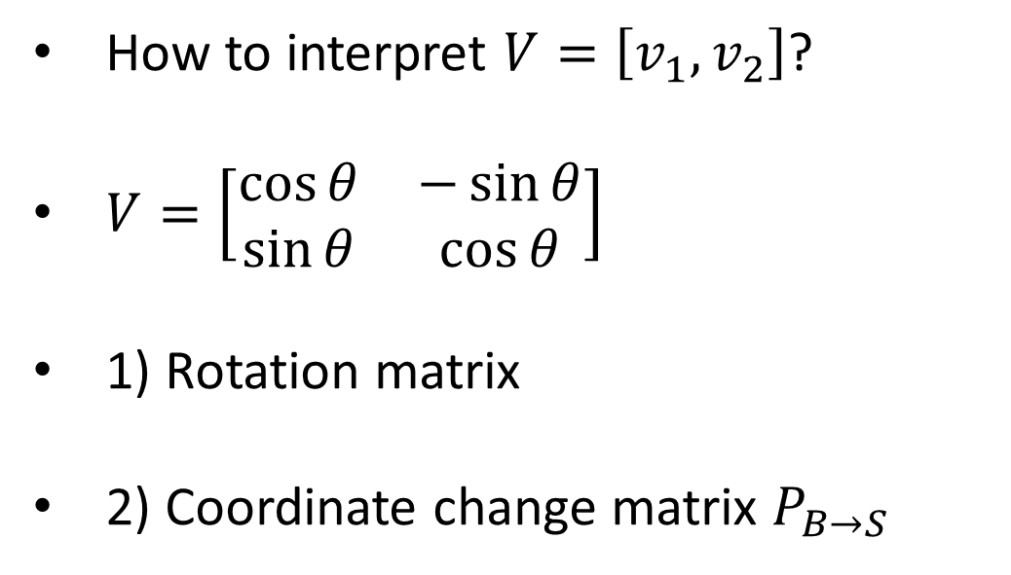
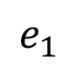
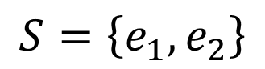
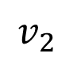
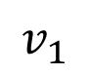
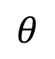
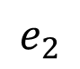
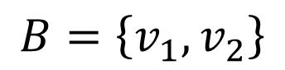
Change of basis – example
How to interpret $V=\left[v_{1},v_{2}\right]$?
$V=\left[\begin{matrix}\cos{θ} & −\sin{θ} \\ \sin{θ} & \cos{θ}\end{matrix}\right]$
1) Rotation matrix
2) Coordinate change matrix $P_{B→S}$
$$v_{2}$$
$$e_{2}$$
$$v_{1}$$
$$θ$$
$$e_{1}$$
$$S=\left\{e_{1},e_{2}\right\}$$
$$B=\left\{v_{1},v_{2}\right\}$$

Slide 30
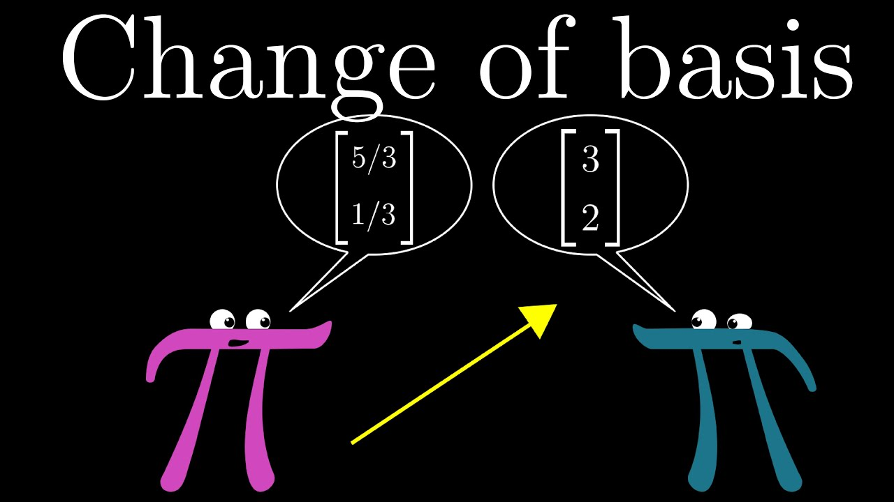
Change of basis

Slide 31
2.2 Matrix representation of linear transformations

Slide 32
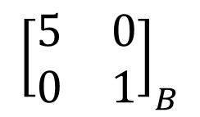
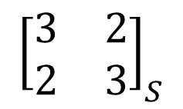
Do linear transformations depend on bases?
$${\left[\begin{matrix}3 & 2 \\ 2 & 3\end{matrix}\right]}_{S}$$
$${\left[\begin{matrix}5 & 0 \\ 0 & 1\end{matrix}\right]}_{B}$$

Slide 33
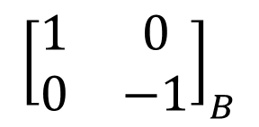
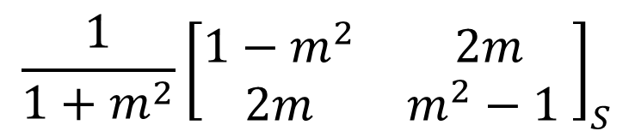
Do linear transformations depend on bases?
$${\frac{1}{1+m^{2}}\left[\begin{matrix}1−m^{2} & 2m \\ 2m & m^{2}−1 \end{matrix}\right]}_{S}$$
$${\left[\begin{matrix}1 & 0 \\ 0 & −1\end{matrix}\right]}_{B}$$

Slide 34
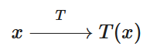
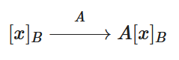
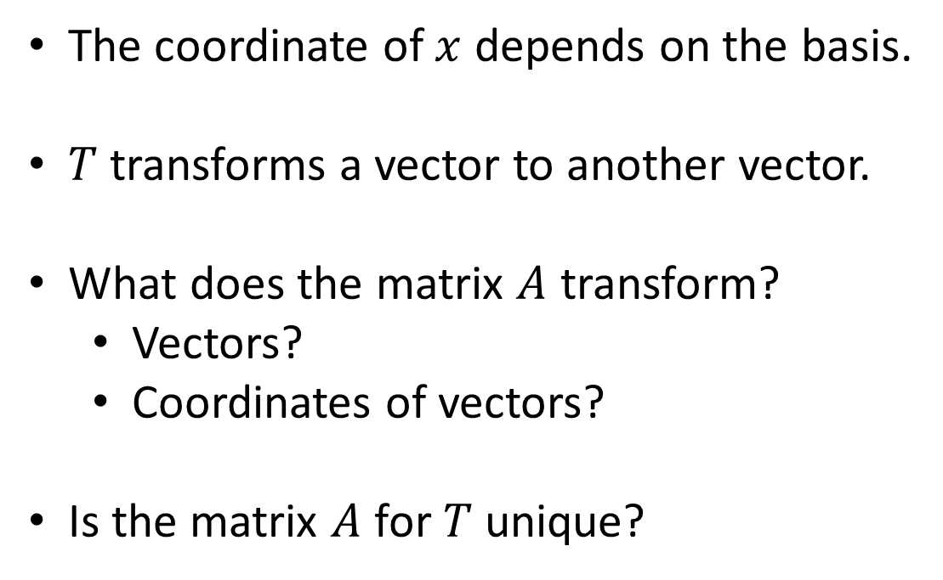
Do linear transformations depend on bases?
The coordinate of $x$ depends on the basis.
$T$ transforms a vector to another vector.
What does the matrix $A$ transform?
Vectors?
Coordinates of vectors?
Is the matrix $A$ for $T$ unique?

Slide 35
Do linear transformations depend on bases?
A matrix represents a linear transformation with respect to a specific basis.
Matrix representation of a linear transformation depends on the choice of basis.
Standard matrix: Matrix representation of a linear transformation with respect to the standard basis.

Slide 36
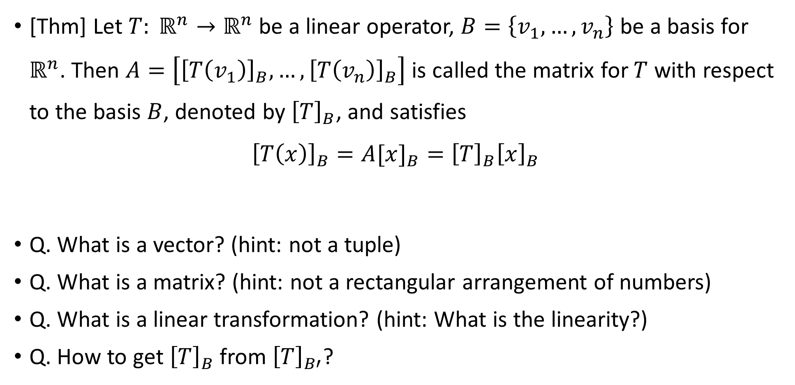
Matrix representation of linear transformations
[Thm] Let $T: ℝ^{n}→ℝ^{n}$ be a linear operator, $B=\left\{v_{1},…,v_{n}\right\}$ be a basis for $ℝ^{n}$. Then $A=\left[{\left[T\left(v_{1}\right)\right]}_{B},…,{\left[T\left(v_{n}\right)\right]}_{B}\right]$ is called the matrix for $T$ with respect to the basis $B$, denoted by ${\left[T\right]}_{B}$, and satisfies
$${\left[T\left(x\right)\right]}_{B}=A[x]_{B}={\left[T\right]}_{B}{\left[x\right]}_{B}$$
Q. What is a vector? (hint: not a tuple)
Q. What is a matrix? (hint: not a rectangular arrangement of numbers)
Q. What is a linear transformation? (hint: What is the linearity?)
Q. How to get ${\left[T\right]}_{B}$ from ${\left[T\right]}_{B′}$?

Slide 37
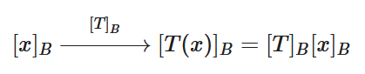
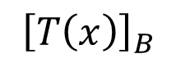








Matrix representation of linear transformations
$${\left[T\right]}_{S}=A$$
Recall that the coordinate change matrix from an ordered basis $B=\left\{v_{1},…,v_{n}\right\}$ to the standard basis $S$ is
$$P_{B→S}=\left[v_{1},…,v_{n}\right]$$
Thus, the followings hold.
$${\left[T\right]}_{S}=P{\left[T\right]}_{B}P^{−1}$$
$${\left[T\right]}_{B}=P^{−1}{\left[T\right]}_{S}P$$
$${\left[x\right]}_{S}$$
$${\left[T\left(x\right)\right]}_{S}$$
$$P^{−1}$$
$$P$$
$${\left[x\right]}_{B}$$
$${\left[T\left(x\right)\right]}_{B}$$
$${\left[T\right]}_{B}$$

Slide 38



Matrix representation of linear transformations
Example

Slide 39



Matrix representation of linear transformations
Example

Slide 40





Matrix representation of linear transformations
$${\left[T\right]}_{B^{′}}$$
$${\left[x\right]}_{B^{′}}$$
$${\left[T\left(x\right)\right]}_{B^{′}}$$
For genelarlization, given a coordinate change matrix $P$ from $B$ to $B^{′}$, the followings hold.
$${\left[T\right]}_{B^{′}}=P{\left[T\right]}_{B}P^{−1}$$
$${\left[T\right]}_{B}=P^{−1}{\left[T\right]}_{B^{′}}P$$
$$P^{−1}$$
$$P$$
$${\left[x\right]}_{B}$$
$${\left[T\left(x\right)\right]}_{B}$$
$${\left[T\right]}_{B}$$

Slide 41

Matrix representation of linear transformations
Bases of domain and codomain of a linear transformation may be different.
[Thm] Let $T: ℝ^{n}→ℝ^{m}$ be a linear transformation, $B=\left\{v_{1},…,v_{n}\right\}$ be a basis for $ℝ^{n}$, $B^{′}=\left\{u_{1},…,u_{m}\right\}$ be a basis for $ℝ^{m}$. Then
$$A=\left[{\left[T\left(v_{1}\right)\right]}_{B^{′}},…,{\left[T\left(v_{n}\right)\right]}_{B^{′}}\right]$$
is the matrix for $T$ with respect to the bases $B$ and $B′$, denoted by ${\left[T\right]}_{B}^{B^{′}}$, and satisfies
$${\left[T\left(x\right)\right]}_{B^{′}}=A[x]_{B}={\left[T\right]}_{B}^{B^{′}}{\left[x\right]}_{B}$$

Slide 42












Matrix representation of linear transformations
$${\left[T\right]}_{B_{1}}^{B_{1}^{′}}$$
$${\left[x\right]}_{B_{1}}$$
$${\left[T\left(x\right)\right]}_{B_{1}^{′}}$$
coordinate change from $B_{1}$ to $B_{2}$, denoted by ${\left[Id\right]}_{B_{1}}^{B_{2}}$
coordinate change from $B_{2}^{′}$ to $B_{1}^{′}$, denoted by ${\left[Id\right]}_{B_{2}^{′}}^{B_{1}^{′}}$
$$V^{−1}$$
$$U$$
$${\left[x\right]}_{B_{2}}$$
$${\left[T\left(x\right)\right]}_{B_{2}^{′}}$$
$${\left[T\right]}_{B_{2}}^{B_{2}^{′}}$$
$${\left[T\right]}_{B_{1}}^{B_{1}^{′}}=U{\left[T\right]}_{B_{2}}^{B_{2}^{′}}V^{−1}={\left[Id\right]}_{B_{2}^{′}}^{B_{1}^{′}}{\left[T\right]}_{B_{2}}^{B_{2}^{′}}{\left[Id\right]}_{B_{1}}^{B_{2}}$$
$${\left[T\right]}_{B_{1}}^{B_{1}^{′}}{\left[x\right]}_{B_{1}}={\left[Id\right]}_{B_{2}^{′}}^{B_{1}^{′}}{\left[T\right]}_{B_{2}}^{B_{2}^{′}}{\left[Id\right]}_{B_{1}}^{B_{2}}{\left[x\right]}_{B_{1}}$$

Slide 43


Matrix representation of linear transformations
Rmk. Since the matrix representation depends on the both bases of domain and codomain, an identity matrix may not represent an identity transformation.
$${\left[T\right]}_{S}^{B}={\left[Id\right]}_{S}^{B}{\left[T\right]}_{S}$$

Slide 44
3. Diagonalization

Slide 45


Some quote
"This chapter begins the "second half" of linear algebra. The first half was about $Ax=b$. The new problem $Ax=λx$ will still be solved making it diagonal if possible." - Linear Algebra and Its Applications, Gilbert Strang.

Slide 46
3.1 Eigenvalues and Eigenvectors

Slide 47

Eigenvalues and Eigenvectors
[Def] If $A$ is an $n×n$ matrix, then a scalar $λ$ is called an eigenvalue of $A$ if there is a nonzero vector $x$ such that $Ax=λ$. Such a vector $x$ is called an eigenvector of $A$ corresponding to $λ$.
Rmk. Eigenvalues are the solutions of $\left|λI−A\right|=0$.
[Def] For an $n×n$ matrix $A$, $\left|λI−A\right|$ is called the characteristic polynomial of $A$.
Q. Does a rotation matrix have eigenvalues?

Slide 48
Eigenvalues and Eigenvectors
Example
What are the eigenvalues and eigenvectors of ${\left[T\right]}_{S}$?

Slide 49












Eigenvalues and Eigenvectors
$${\left[T\right]}_{S}$$
$${\left[x\right]}_{S}$$
$${\left[T\left(x\right)\right]}_{S}$$
$$P^{−1}$$
$$P$$
$${\left[x\right]}_{B}$$
$${\left[T\left(x\right)\right]}_{B}$$
$${\left[T\right]}_{B}$$

Slide 50

Eigenvalues and Eigenvectors
lab: example_direction_of_eigenvectors.m

Slide 51

Linear independence of eigenvectors
[Thm] If $v_{1}, …, v_{k}$ are eigenvectors of a matrix $A$ that corresponding to distinct eigenvalues $λ_{1}, …, λ_{k}$, then the set $\{v_{1}, …, v_{k}\}$ is linearly independent.
[Cor] If an $n×n$ matrix $A$ has $n$ distinct eigenvalues, then the set of eigenvectors of $A$ forms a basis of $ℝ^{n}$.
Q. What if an $n×n$ matrix $A$ have less than $n$ eigenvalues?

Slide 52

Multiplicity of eigenvalues and eigenspaces
[Def] If the characteristic polynomial of an $n×n$ matrix $A$ is factored as
$$\left|λI−A\right|={\left(λ−λ_{1}\right)}^{m_{1}}{\left(λ−λ_{2}\right)}^{m_{2}}…{\left(λ−λ_{k}\right)}^{m_{k}}$$
then $m_{i}$ is called the algebraic multiplicity of the eigenvalue $λ_{i}$.
[Def] If $λ_{0}$ is an eigenvalue of $A$, the solution space of
$$\left(λ_{0}I−A\right)x=0$$
is called the eigenspace of A corresponding to $λ_{0}$.
The dimension of this eigenspace is called the geometric multiplicity of $λ_{0}$.

Slide 53


Multiplicity of eigenvalues and eigenspaces
Find the…
Characteristic polynomial of $A$
Eigenvalues and eigenvectors
Algebraic multiplicity and geometric multiplicity of each eigenvalue
Eigenspace for each eigenvalue
lab: example_eigenvalue_problem.m

Slide 54

Invertibility of a square matrix
An $n×n$ matrix $A$ is invertible if and only if
$Ax=0$ has only a trivial solution, i.e., $\ker\left(T_{A}\right)=\left\{0\right\}$.
$\det\left(A\right)≠0$
A set of column (row) vectors of $A$ forms a basis of $ℝ^{n}$, i.e., $Im\left(T\right)=ℝ^{n}$.
$rank(A) = n$, $nullity\left(A\right)= 0$
$T_{A}$ is 1-1 and onto.
0 is not an eigenvalue of $A$.

Slide 55
3.2 Matrix similarity

Slide 56
What is the matrix similarity?
$${\left[T\right]}_{S}$$
$${\left[x\right]}_{S}$$
$${\left[T\left(x\right)\right]}_{S}$$
$$P^{−1}$$
$$P$$
$${\left[x\right]}_{B}$$
$${\left[T\left(x\right)\right]}_{B}$$
$${\left[T\right]}_{B}$$

Slide 57

Matrix similarity
[Def] If $A$ and $C$ are square matrices with the same size, then we say that $C$ is similar to $A$, denote $A∼C$, if there exists an invertible matrix $P$ such that $C = P^{−1}AP$.
[Thm] If $A$ and $C$ are two matrix representations of the same linear operator, then $A$ is similar to $C$. The inverse is also true.
[Cor] If $A∼C$, then $C∼A$.

Slide 58
Similar matrices are similar
[Thm] Similar matrices have similarity invariants such as:
the same determinant.
the same rank.
the same nullity.
the same trace.
the same characteristic polynomial.
the same eigenvalues with the same algebraic and geometric multiplicities.
Q. Are the properties above for a matrix or a linear operator?
Q. If two matrices have same properties above, are they similar?
lab: example_similarity_check.m

Slide 59
3.3 Eigenvalue Decomposition

Slide 60






Motivation of Diagonalization

Slide 61

The Diagonalization Problem
[Def] For a square matrix $A$, if there exists an invertible matrix $P$ such that $P^{−1}AP$ is diagonal, then $A$ is said to be diagonalizable, and $P$ is said is to diagonalize $A$.
[Thm] An $n×n$ matrix $A$ is diagonalizable $⇔$ $A$ has $n$ linearly independent eigenvectors. $⇔$ Eigenvectors of $A$ form a basis of $ℝ^{n}$.
$$A=PDP^{−1}$$
Column vectors are eigenvectors.
Diagonal terms are eigenvalues.

Slide 62

Diagonalizability of matrices
[Thm] An $n×n$ matrix with $n$ distinct real eigenvalues is diagonalizable.
[Thm] If $A$ is an $n×n$ matrix, then
(a) The geometric multiplicity of an eigenvalue of A is less than or equal to its algebraic multiplicity.
(b) $A$ is diagonalizable. $⇔$ The sum of the geometric multiplicities of its eigenvalues is $n$. $⇔$ The geometric multiplicity of each eigenvalue of $A$ is the same as its algebraic multiplicity.
Rmk. Diagonalizability does not mean distinct eigenvalues.

Slide 63

Diagonalizability of matrices: example
Is $A$ diagonalizable?
If so, find an invertible matrix $P$ and a diagonal matrix $D$ such that $A = PDP^{−1}$.
lab: example_eigenvalue_problem.m

Slide 64









We still care the orthonormal bases
$${\left[T\right]}_{S}=A$$
It is almost always better to have an orthonormal basis.
When can a square matrix $A$ be decomposed like this:
$$A=PDP^{T}$$
$${\left[x\right]}_{S}$$
$${\left[T\left(x\right)\right]}_{S}$$
$$P^{−1}$$
$$P$$
$${\left[x\right]}_{B}$$
$${\left[T\left(x\right)\right]}_{B}$$
$${\left[T\right]}_{B}$$

Slide 65










The Orthogonal Diagonalization Problem
[Def] For a square matrix $A$, if there exists an orthogonal matrix $P$ such that $P^{T}AP$ is diagonal, then $A$ is said to be orthogonally diagonalizable, and $P$ is said is to orthogonally diagonalize $A$.
$${\left[T\right]}_{S}=A$$
$${\left[x\right]}_{S}$$
$${\left[T\left(x\right)\right]}_{S}$$
$$A=PDP^{T}$$
$$P^{T}$$
$$P$$
$${\left[x\right]}_{B}$$
$${\left[T\left(x\right)\right]}_{B}$$
Column vectors are eigenvectors.
Diagonal terms are eigenvalues.
$${\left[T\right]}_{B}$$

Slide 66

Orthogonal diagonalizability of matrices
[Thm] An $n×n$ matrix $A$ is orthogonally diagonalizable. $⇔$ There exists an orthonormal set of $n$ eigenvectors of $A$. $⇔$ $A$ is symmetric.
[Thm] If a square matrix $A$ is symmetric, then eigenvectors from different eigenspaces are orthogonal.
Rmk. For any square matrix, eigenvectors from different eigenspaces are linearly independent.

Slide 67

Spectral decomposition
If a matrix $A$ is orthogonally diagonalizable, then
$$A= P D P^{T}$$
$$=λ_{1}p_{1}p_{1}^{T}+…+λ_{n}p_{n}p_{n}^{T}$$
which is called a spectral decomposition (or an eigenvalue decomposition).

Slide 68

Geometric interpretation of EVD
lab: example_geometric_interpretation_of_EVD.m

Slide 69

eigshow
Q. Equation of the ellipse?
Q. Direction of major/minor axes?
lab: eigshow.m

Slide 70
Geometric interpretation of diagonalization
lab: example_diagonalization.m

Slide 71
3.4 Singular Value Decomposition

Slide 72

Motivation of SVD
Even if a square matrix $A$ is not symmetric, $A$ may be decomposed as $A=PDP^{−1}$ where $P$ is not orthogonal.
However, an orthogonal matrix or an orthonormal basis is too good to abandon.
What do we have to throw away?
1) $A=PHP^{T}$ where $P$ is orthogonal and $H$ is upper-triangular. (Hessenberg, Schur)
2) $A=UΣV^{T}$ where $U$, $V$ are orthogonal and $Σ$ is diagonal. (SVD)
Can we even decompose a non-square matrix in the form of $A=UΣV^{T}$?

Slide 73


Singular Value Decomposition; SVD
[Thm] If $A$ is an $n×n$ matrix of rank $k$, then $A$ can be factored as
$$A=UΣV^{T}$$
where $U$ and $V$ are $n×n$ orthogonal matrices and $Σ$ is an $n×n$ diagonal matrix whose main diagonal has $k$ positive entries and $n−k$ zeros.

Slide 74











Singular Value Decomposition; SVD
$${\left[T\right]}_{S}=A$$
$${\left[x\right]}_{S}$$
$${\left[T\left(x\right)\right]}_{S}$$
coordinate change from $S$ to $V$, or ${\left[Id\right]}_{S}^{V}$
coordinate change from $U$ to $S$, or ${\left[Id\right]}_{U}^{S}$
$$V^{T}$$
$$U$$
$${\left[x\right]}_{V}$$
$${\left[T\left(x\right)\right]}_{U}$$
$${\left[T\right]}_{V}^{U}=Σ$$
$$A=UΣV^{T}$$
Rmk. Domain and codomain of $Σ$ have different bases.

Slide 75
eigshow
Q. Equation of the ellipse?
Q. Direction of major/minor axes?
lab: eigshow.m

Slide 76
Geometric interpretation of SVD
lab: example_SVD.m

Slide 77


Singular Value Decomposition; SVD
Rmk.
$A^{T}A=VDV^{T}$ where $D$ is diagonal and $diag\left(D\right)≥0$.
$Σ^{2}=D$.
Main diagonal of $Σ$ are in nonincreading order.
$σ_{i}$: singular values of $A$
$u_{i}$: left singular vectors of $A$
$v_{i}$: right singular vectors of $A$

Slide 78





SVD of a general matrix
[Thm] If $A$ is an $m×n$ matrix of rank $k$, then $A$ can be factored as
$$A=UΣV^{T}$$
$$m×m$$
$$m×n$$
$$n×n$$

Slide 79






Reduced SVD
$$=U_{1}Σ_{1}V_{1}^{T}$$
$$m×k$$
$$k×k$$
$$k×n$$

Slide 80


Reduced singular value expansion
$$A=U_{1}Σ_{1}V_{1}^{T}$$
$$=σ_{1}u_{1}v_{1}^{T}+…+σ_{k}u_{k}v_{k}^{T}$$

Slide 81
Image compression using SVD
lab: example_cameraman_image_compression.m

Slide 82
Principal Component Analysis (PCA)
height (cm) | weight (kg)
170 | 70
150 | 45
160 | 55
180 | 60
172 | 80
100 | 17
110 | 20
90 | 20
105 | 18
88 | 21
Data for height and weight
What is the principal axis?
How to divide into two groups?

Slide 83




Principal Component Analysis (PCA)
height (cm) | weight (kg)
170 | 70
150 | 45
160 | 55
180 | 60
172 | 80
100 | 17
110 | 20
90 | 20
105 | 18
88 | 21
$$X=$$
$$X_{c}=X−mean\left(X\right)$$
$$Y=X_{c}V$$
➔ Covariance matrix of $Y$ should be diagonal.

Slide 84





Principal Component Analysis (PCA)
Column vectors of $V$ are principal axes.
lab: example_PCA_simple.m

Slide 85
Principal Component Analysis (PCA)
300 fruit images are given.
The size of each image is 100 x 100.
How to divide the fruit images into three groups?

Slide 86







Principal Component Analysis (PCA)
flattened single image
$$X=$$
single feature (pixel value)
$$V=$$
$$X_{c}=UΣV^{T}$$
principal axes
$$300×300$$
$$300×10000$$
$$300×300$$

Slide 87
Principal Component Analysis (PCA)
lab: example_PCA_fruit.m

Slide 88
3.5 Pseudoinverse

Slide 89








Inverse of a non-square matrix
$$B$$
$$A$$
$$B$$
$$ℝ^{m}$$
$$ℝ^{n}$$
$$ℝ^{m}$$
$$ℝ^{n}$$
Let $A$ be an $m×n$ matrix $A$ with full row rank ($m<n$).
Is there an $n×m$ matrix $B$ such that $BA=I_{n}$?
Is there an $n×m$ matrix $B$ such that $AB=I_{m}$?

Slide 90


























Inverse of a non-square matrix
$${\left[T\right]}_{S}=A$$
$${\left[T\right]}_{S}=A$$
$${\left[x\right]}_{S}$$
$${\left[T\left(x\right)\right]}_{S}$$
$${\left[x\right]}_{S}$$
$${\left[T\left(x\right)\right]}_{S}$$
$$V^{T}$$
$$U$$
$$V_{1}^{T}$$
$$U_{1}$$
$${\left[x\right]}_{V}$$
$${\left[T\left(x\right)\right]}_{U}$$
$${\left[x\right]}_{V}$$
$${\left[T\left(x\right)\right]}_{U}$$
$${\left[T\right]}_{V}^{U}=Σ$$
$${\left[T\right]}_{V}^{U}=Σ_{1}$$
$$A=U_{1}Σ_{1}V_{1}^{T}$$
$$A=UΣV^{T}$$
$$m×m$$
$$m×n$$
$$n×n$$
$$m×m$$
$$m×m$$
$$m×n$$
Reversing the direction works for the reduced SVD if $A$ has full row rank.
Reversing the direction does not work because $Σ$ is not square.

Slide 91

Inverse of a non-square matrix
Let $A$ be an $m×n$ matrix, $A=U_{1}Σ_{1}V_{1}^{T}$ be the SVD of $A$, $A^{+}=V_{1}Σ_{1}^{−1}U_{1}^{T}$.
If $A$ is full row rank, $AA^{+}=I_{m}$, which is called the right inverse of $A$.
If $A$ is full column rank, $A^{+}A=I_{n}$, which is called the left inverse of $A$.
[Thm] If $A$ is an $m×n$ matrix with full column rank, then
$$A^{+}={\left(A^{T}A\right)}^{−1}A^{T}$$
If $A$ has full row rank, then
$$A^{+}=A^{T}{\left(AA^{T}\right)}^{−1}$$

Slide 92

Properties of pseudoinverse
If $A^{+}$ is the pseudoinverse of an $m×n$ matrix $A$, then:
(a) $AA^{+}A=A$
(b) $A^{+}AA^{+}=A^{+}$
(c) ${\left(AA^{+}\right)}^{T}=AA^{+}$
(d) ${\left(A^{+}A\right)}^{T}=A^{+}A$
(e) ${\left(A^{T}\right)}^{+}={\left(A^{+}\right)}^{T}$
(f) $A^{++}=A$

Slide 93




Pseudoinverse solves the Least Square Prob.
$${\text{proj}}_{col\left(A\right)}y=A{\left(A^{T}A\right)}^{−1}A^{T}y$$
$$\hat{y}=Ax$$
$$x={\left(A^{T}A\right)}^{−1}A^{T}y=A^{+}y$$
$AA^{+}y$ is the projection of $y$ onto $col(A)$.
Best fit is projecting $y$ onto $col(A)$.
lab: example_least_square_is_projection.m

Slide 94









Condition number
$${\left[T\right]}_{S}=A$$
What matters is $Σ$ which stretches/compresses a vector in each direction.
[Def] Condition number of a matrix $A$ is the ratio of the largest singular value of $A$ to the smallest singular value of $A$.
$$cond\left(A\right)=\frac{σ_{1}}{σ_{k}}$$
Condition number of $A$ is too large. ≡ Some dimension of $Im(A)$ is negligible. ≡ $A$ is near-singular.
$${\left[x\right]}_{S}$$
$${\left[T\left(x\right)\right]}_{S}$$
$$V^{T}$$
$$U$$
$${\left[x\right]}_{V}$$
$${\left[T\left(x\right)\right]}_{U}$$
$${\left[T\right]}_{V}^{U}=Σ$$
lab: eigshow.m

Slide 95


Slide 96
Multibody vibration problem is an eigenvalue problem.

Slide 97










Compliant mechanisms
$$Q$$
$$M$$
$$P$$
$$L$$
$$δ_{x}=\frac{PL}{EA}$$
$$δ_{y}=\frac{QL^{3}}{3EI}+\frac{ML^{2}}{2EI}$$
$$θ_{z}=\frac{QL^{2}}{2EI}+\frac{ML}{EI}$$
$$x=Cf$$
$$f=Kx$$

Slide 98



2-DOF system

Slide 99



2-DOF system
$$M\ddot{x}+Kx=0$$
[V, D] = eig(K*inv(M));
[V, D] = eig(inv(sqrt(M))*K*inv(sqrt(M)));
[V, D] = eig(K, M);
$$\left(K−ω^{2}M\right)x=0$$
$$KM^{−1}x=ω^{2}x$$

Slide 100






Multi-mass Compliant Mechanism
$$Q$$
$$M\ddot{x}+Kx=0$$
$$m_{1},I_{1}$$
[V, D] = eig(K*inv(M));
[V, D] = eig(inv(sqrt(M))*K*inv(sqrt(M)));
[V, D] = eig(K, M);
$$m_{2},I_{2}$$
$$P$$
$$M$$
See also.
https://ocw.snu.ac.kr/node/30658

